Slide 1
Configuration Management
Final Presentation
Software Process and Quality Management

Slide 2





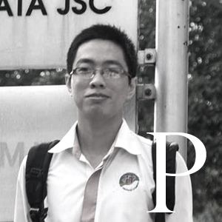
MEET THE TEAM
BigFive
®
K16T1

Slide 3

Session Agenda
Configuration Process (Traditional)
Configuration Process (Agile)
PIID

Slide 4
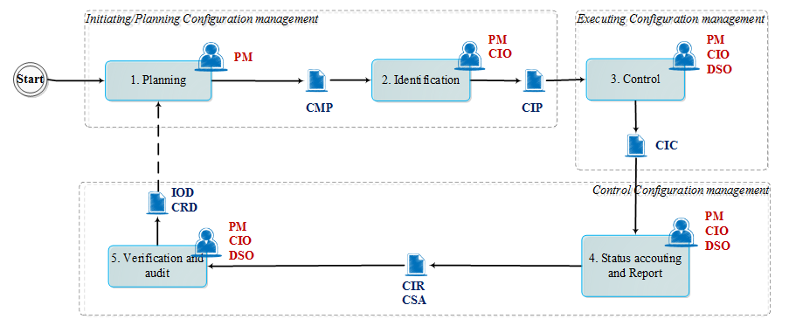
Configuration Process (Agile) - Overview
1

Slide 5
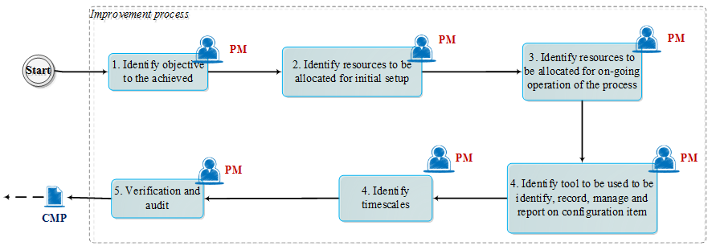
Planning
1

Slide 6
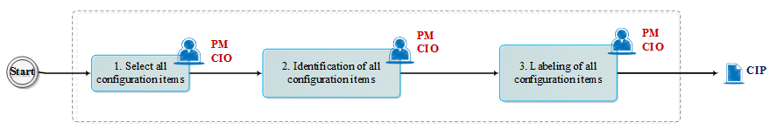
Identification
1

Slide 7
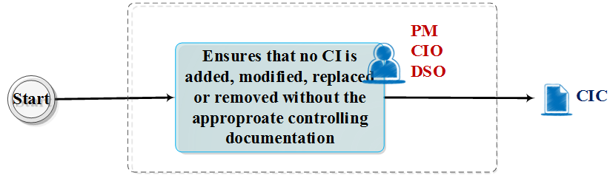
Control
1

Slide 8
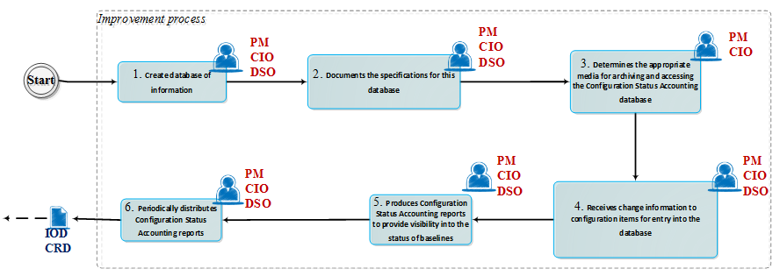
Status Accounting and Report
1

Slide 9
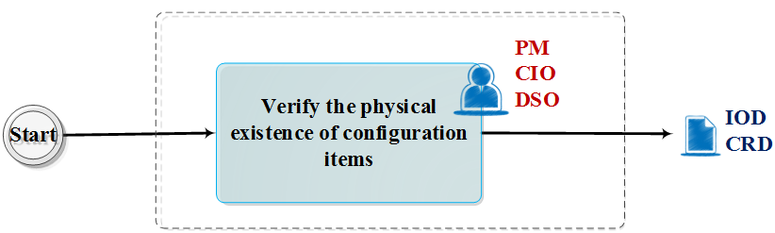
Verification and Audit
1

Slide 10
Template List
Change-Log
Chang Request
Configuration Items Control
Configuration Items Plan for Agile
Configuration Items Report
Configuration Management Process for Agile
Improvement Objective Document
1

Slide 11
Q & A

